Slide 1

light up the web with lit-html 🔥
@mikegeyser
30 November 2019
South Africa

Slide 2


Sorry!
@mikegeyser

Slide 3

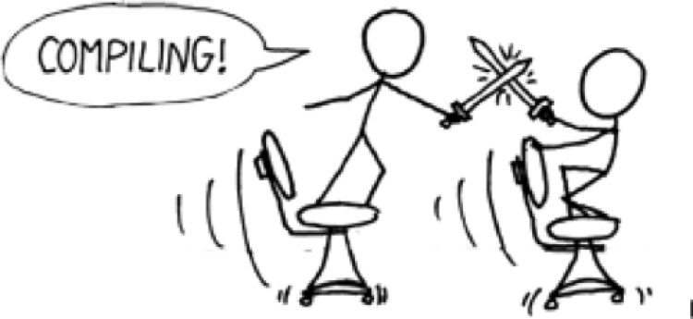
@mikegeyser

Slide 4

@mikegeyser

Slide 5

Web Almanac
HTTP Archive's annual state of the web report
@mikegeyser

Slide 6
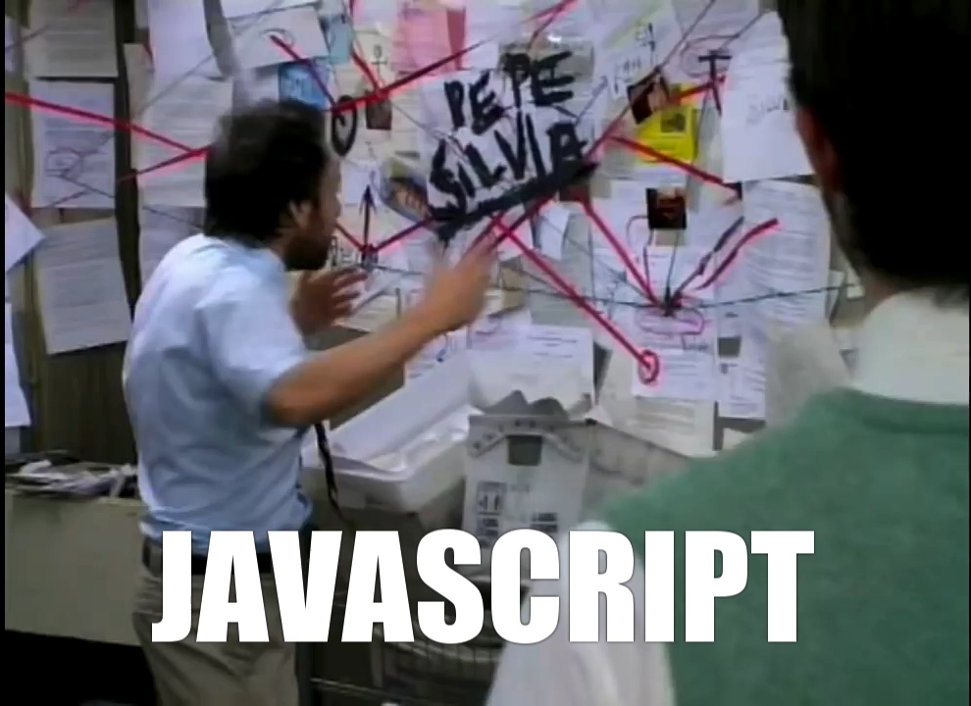

Slide 7




ES5
ES6
ES2015
ES2016
ES2017
ES2018
@mikegeyser

Slide 8
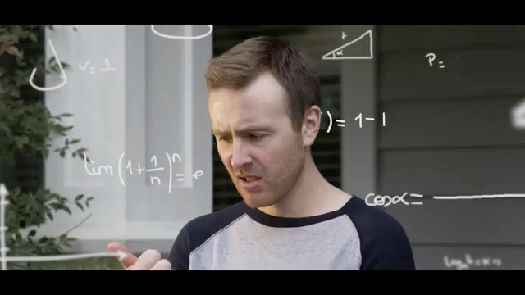

Slide 9
ES2015+
Web Components
+
🔥
@mikegeyser

Slide 10
what we’ll use
es-dev-server
-> Bare module imports
lit-html
-> Template rendering
LitElement
-> Change detection
@mikegeyser

Slide 11
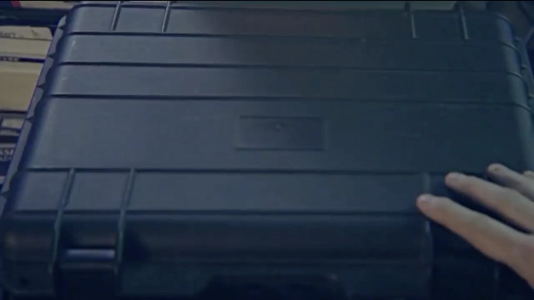
DEMO TIME

Slide 12
in summary
It can (and should) be easier.
It doesn’t *have* to be this (it just works for me).
Keep it simple. Use the platform.
@mikegeyser

Slide 13
questions?
@mikegeyser
mikerambl.es/videos
lit-html.polymer-project.org
South Africa

